Slide 1
ANGULAR
Angular Interview Questions For 3 Years Of Experience
https://www.linkedin.com/pulse/angular-interview-questions-3-years-experience/
Top 60+ Angular Interview Questions and Answers for 2024
https://www.simplilearn.com/tutorials/angular-tutorial/angular-interview-questions
Angular Interview Questions
https://www.interviewbit.com/angular-interview-questions/

Slide 2
Angular Basic Interview Questions for Freshers

Slide 3
1. What is Angular?
Angular is an open-source web application development framework created by Google.
It is used to build front-end and single-page applications that run on JavaScript.
It is a full-fledged framework, i.e, it takes care of many aspects of front–end web applications such as HTTP requests, routing, layout, forms, reactivity, validation, etc.

Slide 4
2. What are the technologies used in Angular?
Angular is a modern front-end JavaScript framework developed by Google.
Angular itself makes use of several technologies for several reasons to accomplish certain tasks easily as well as to allow developers to have a better experience while developing applications with it.
Angular uses TypeScript, which is a superscript of JavaScript. So, any valid JavaScript is a valid TypeScript.
However, TypeScript allows us to write JavaScript as a strongly typed language, and we can define our own types as well, which makes catching bugs much easier.
It also uses RxJS, which allows developers to better deal with asynchronous operations.

Slide 5
3. Why were client-side frameworks like Angular introduced?
https://intellipaat.com/blog/interview-question/angular-interview-questions/#angular_interview_questions_for_experienced_professionals_2_to_5_years

Slide 6
4. How does an Angular application work?
https://intellipaat.com/blog/interview-question/angular-interview-questions/#angular_interview_questions_for_experienced_professionals_2_to_5_years

Slide 7
Angular Interview Questions and Answers

Slide 8
What is Angular?

Slide 9
00:04:50 - What are Angular advantages?

Slide 10
00:07:32 - What is the difference between AngularJS and Angular?

Slide 11
00:10:42 - What is NPM?

Slide 12
00:12:16 - What is CLI tool?

Slide 13
00:13:57 - Section 2 00:14:25 - What are Components in Angular?

Slide 14
00:17:14 - What is a Selector and Template?

Slide 15
00:18:40 - What is Module in Angular? What is app.module.ts file?

Slide 16
00:21:43 - How an Angular App gets Loaded and Started? What are index.html, app-root, selector and main.ts?

Slide 17
00:25:42 - What is a Bootstrapped Module & Bootstrapped Component?

Slide 18
00:27:20 - Section 3 00:27:54 - What is Data Binding in Angular?

Slide 19
00:30:13 - What is String Interpolation in Angular?

Slide 20
00:32:08 - What is Property Binding in Angular?

Slide 21
00:35:06 - What is Event Binding in Angular?

Slide 22
00:38:07 - What is Two way Binding in Angular?

Slide 23
00:41:55 - Section 4 00:42:19 - What are Directives? What are the type of directives?

Slide 24
00:44:49 - What is *ngIf Structural directive?

Slide 25
00:46:43 - What is *ngFor Structural directive?

Slide 26
00:48:06 - What is *ngSwitch Structural directive?

Slide 27
00:50:35 - What is [ngStyle] Attribute directive?

Slide 28
00:53:45 - What is [ngClass] Attribute directive?

Slide 29
00:56:26 - What is the difference between Component, Attribute and Structural Directives?

Slide 30
00:58:08 - Section 5 00:58:29 - What is Decorator?

Slide 31
01:00:15 - What are the types of Decorator?

Slide 32
01:01:05 - What are Pipes? What are the types of Pipes & Parameterized Pipes?

Slide 33
01:03:25 - What is Chaining Pipes?

Slide 34
01:04:14 - Section 6 01:04:38 - Explain Services with Example?

Slide 35
01:06:32 - How to create Servicein Angular?

Slide 36
01:10:04 - How to use Dependency Injector with Services in Angular?

Slide 37
01:11:56 - What is Hierarchical Dependency Injection?

Slide 38
01:14:34 - What is Provider in Angular?

Slide 39
01:15:46 - What is the role of @Injectable Decorator in a Service?

Slide 40
01:19:57 - Section 7 01:20:11 - What are Parent-Child Components?

Slide 41
01:23:40 - What are Lifecycle Hooks in Angular?

Slide 42
01:27:09 - What is a Constructor in Angular?

Slide 43
01:29:24 - What is ngOnInit life cycle hook in Angular?

Slide 44
01:30:52 - What is the difference between constructor and ngOnInit?

Slide 45
01:35:21 - Section 8 01:36:01 - What are Asynchronous operations?

Slide 46
01:38:20 - What is the difference between Promise and Observable?

Slide 47
01:42:47 - What is RxJS?

Slide 48
01:45:21 - What is Observable? How to implement Observable

Slide 49
01:50:10 - What is the role of HttpClient in Angular?

Slide 50
01:51:26 - Section 9 01:51:50 - What is Typescript? Or What is the difference between Typescript and Javascript?

Slide 51
01:57:55 - What is the difference between let and var keyword?

Slide 52
2:00:59 - What is Type annotation?

Slide 53
02:02:27 - What are Built in/ Primitive and User-Defined/ Non-primitive Types in Typescript?

Slide 54
02:04:21 - What is “any” type in Typescript?

Slide 55
02:06:37 - What is Enum type in Typescript?

Slide 56
02:08:48 - What is Type Assertion in Typescript?

Slide 57
02:10:47 - What are Arrow Functions in Typescript?

Slide 58
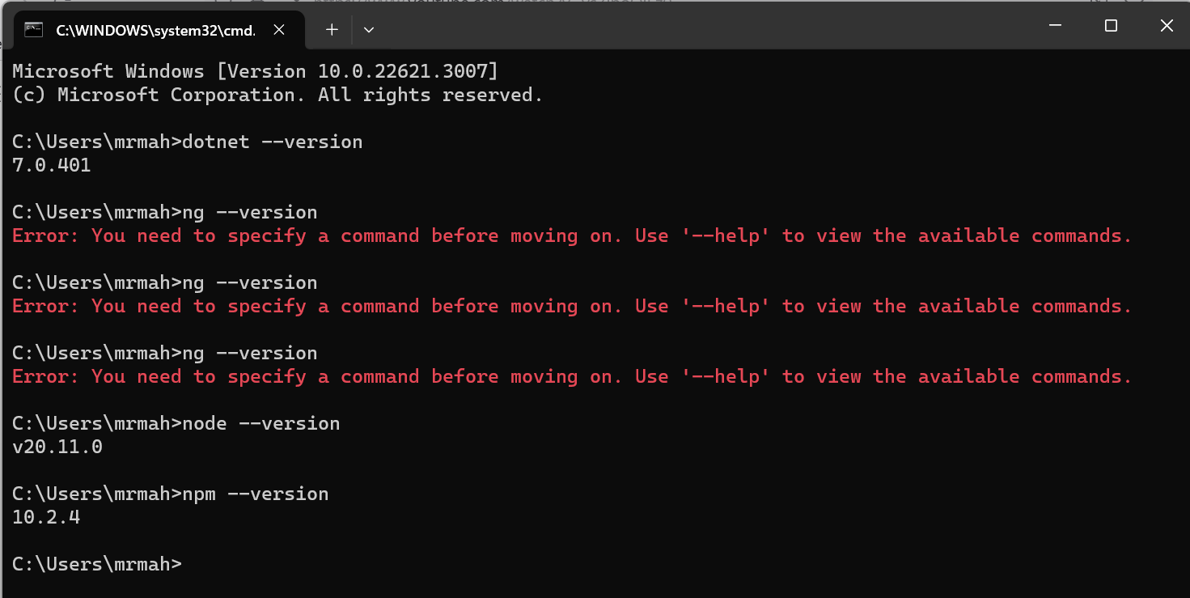
Install node js
To install latest version of Node js
https://nodejs.org/en/download
To check version of node js
Use command prompt and type
node –version or node –v
Current version is V20.11.0
To check npm version
Use command
npm --version

Slide 59
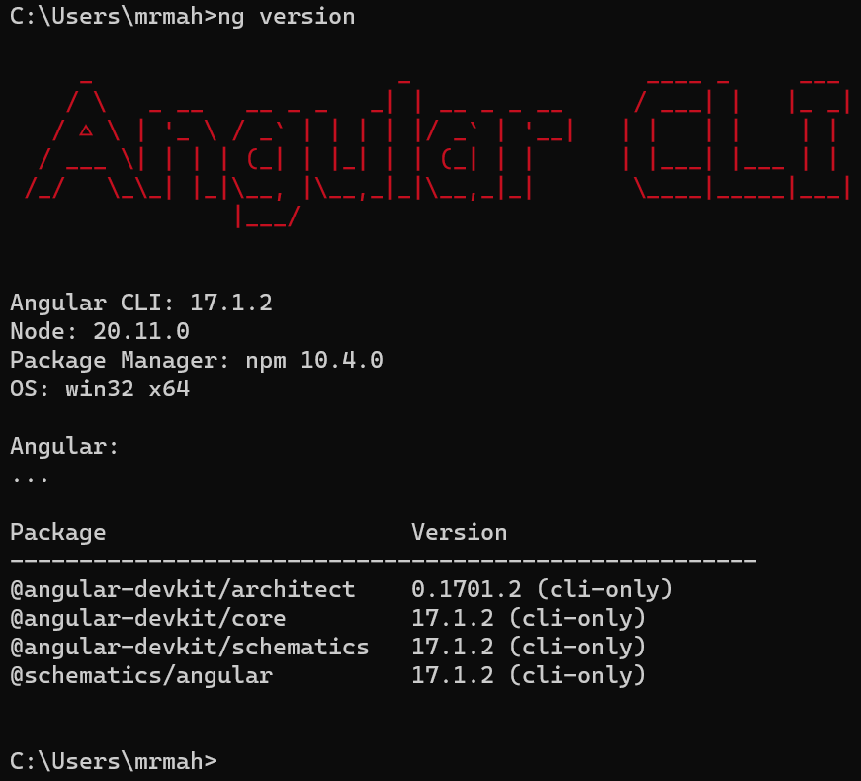
To install Angular
npm install –g @angular/cli
If the angular version is not updated then type below command to update existing angular
npm install –g npm@<<Latest version mentioned after installation of anuglar>>
Ex
npm install –g npm@10.4.0
To check all angular, node and windows versions type below
ng --version

Slide 60
First program in angular
Create a New Angular Project: Open your terminal or command prompt, navigate to the directory where you want to create your Angular project, and run the following command:
ng new hello-world-app
This will create a new Angular project named hello-world-app.
Navigate to the Project Directory: Navigate to the project directory:
cd hello-world-app
Generate a Component: Generate a new component named hello-world:
ng generate component hello-world
Run the Application: Run the Angular application:
ng serve –open
This command will compile the Angular application and open it in your default web browser.

Slide 61
Before Update Angular
Please uninstall angular and then install latest version of angular
To uninstall
npm uninstall –g @angular/cli
npm install –g @angular/cli@latest

Slide 62
What is angular?
Angular is a JavaScript framework for building single page application or SPA applications using HTML and typescript.
Angular is primarily written in TypeScript and implements core functionality as a set of TypeScript library that you import into your apps.
Angular, a powerful front-end web application framework developed and maintained by Google, offers several advantages that contribute to its popularity and effectiveness in building dynamic and scalable web applications. Here are some of the key advantages of Angular:
Once the initial application has loaded into the browser, further interactions only load the additional data needed, without reloading the entire page.
Browser Compatibility : Angular works cross-platform and compatible with multiple browsers. An Angular application can typically run on all browsers (Eg: Chrome, Firefox) and operating systems, such as Windows, macOS, and Linux.

Slide 63
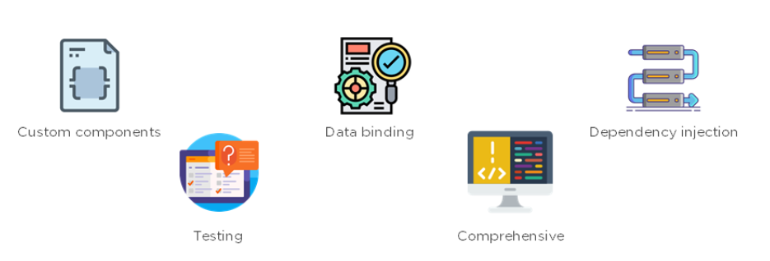
Silent feature of Angular
Custom Components
Angular enables users to build their components that can pack functionality along with rendering logic into reusable pieces.
Data Binding
Angular enables users to effortlessly move data from JavaScript code to the view, and react to user events without having to write any code manually.
Dependency Injection
Angular enables users to write modular services and inject them wherever they are needed. This improves the testability and reusability of the same services.
Comprehensive
Angular is a full-fledged JavaScript framework and provides out-of-the-box solutions for server communication, routing within your application, and more.
Testing
Tests are first-class tools, and Angular has been built from the ground up with testability in mind. You will have the ability to test every part of your application—which is highly recommended.

Slide 65
Basic CRUD operations : Prerequisite
Angular CLI
Node
Package Manager : npm
Bootstrap for css : copy cdn link from URL and paste in index.html head
Javascript : copy cdn link from URL and paste in index.html head
Dot net
URL : https://getbootstrap.com/docs/5.1/getting-started/introduction/
Copy and include Navbar in app.component.html above <router-outlet></router-outlet> from URL (Search for Navbar)
https://www.youtube.com/watch?v=CdE6rVfPJ9I

Slide 66
Basic CRUD operations : Prerequisite
Create one folder Angular CRUD (Use GUI)
Create another inside Angular CRUD like FullStack UI to store Angular UI project.
ng new FullStack.UI (Use command prompt)
Select CSS
Once the installation done go to FullStack.UI and open Visual Studio Code using below command.
code .

Slide 67
Basic CRUD operations : Prerequisite
To create new component
Create new component folder inside src\app\
Create component using command prompt ng g c <<Component Name>>
g : Generate
c : Component
Component name : name to the component

Slide 68
Basic CRUD operations : Prerequisite
As we have created SPA we should not expect to change the URL.
For that change in

Slide 69
Basic CRUD operations : Prerequisite
<router-outlet></router-outlet> in Angular is responsible for dynamically rendering the component associated with the current route. When you define routes in your Angular application and navigate to a specific route, Angular's router matches the URL to the corresponding route configuration and renders the associated component's template inside the <router-outlet> directive.

Slide 70
.Net Core
Add below three nuget packages to the Visual Studio.
Entity Framework Core
Entity Framework Tools
Entity Framework SQL

Slide 71
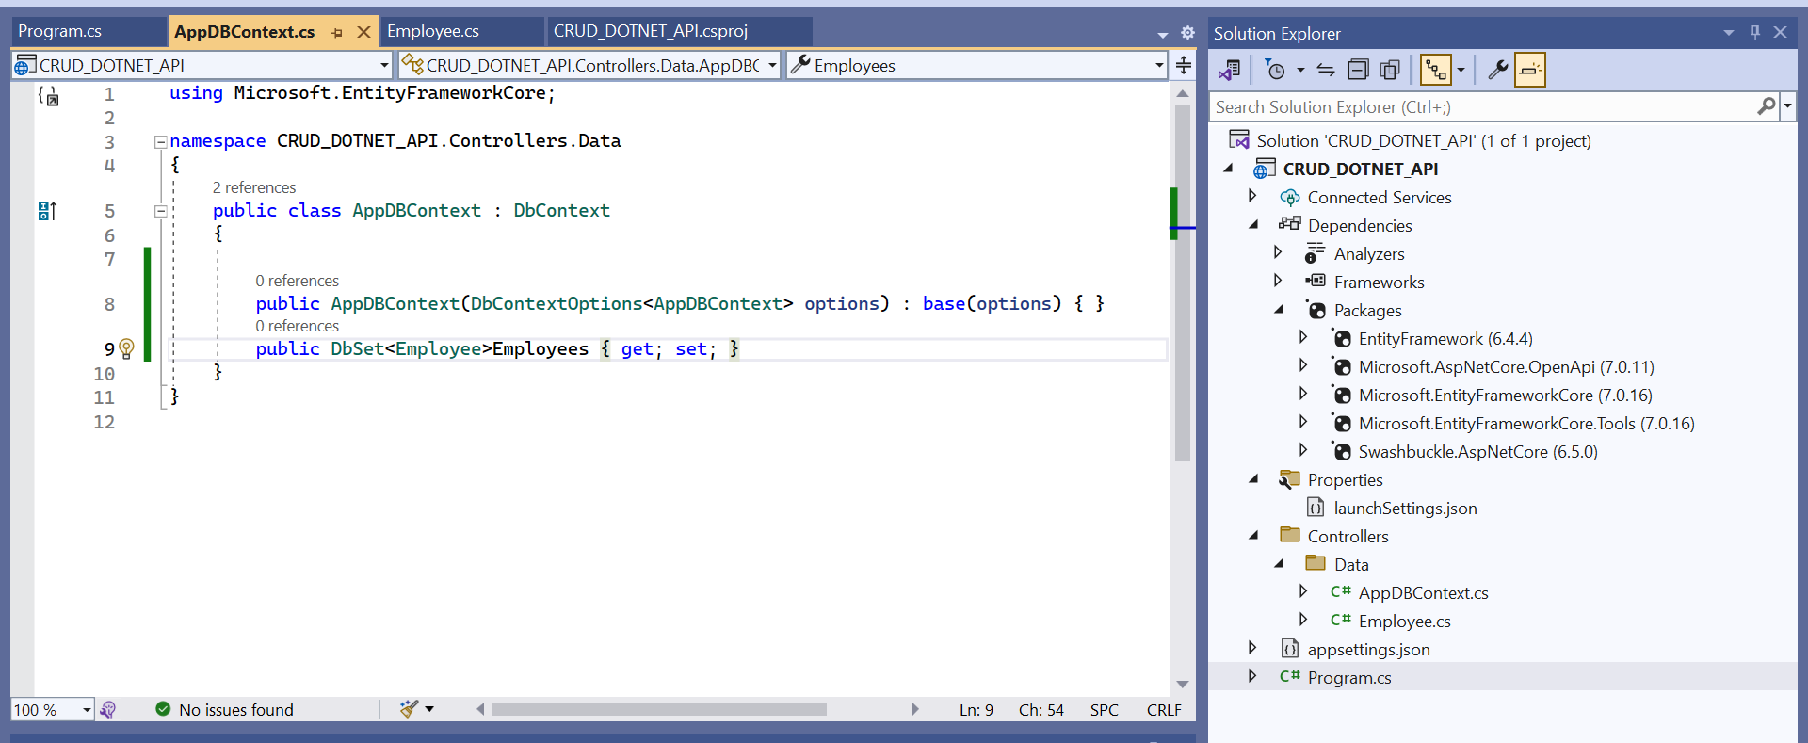
.Net Core
Create DbSet to initialise table

Slide 72
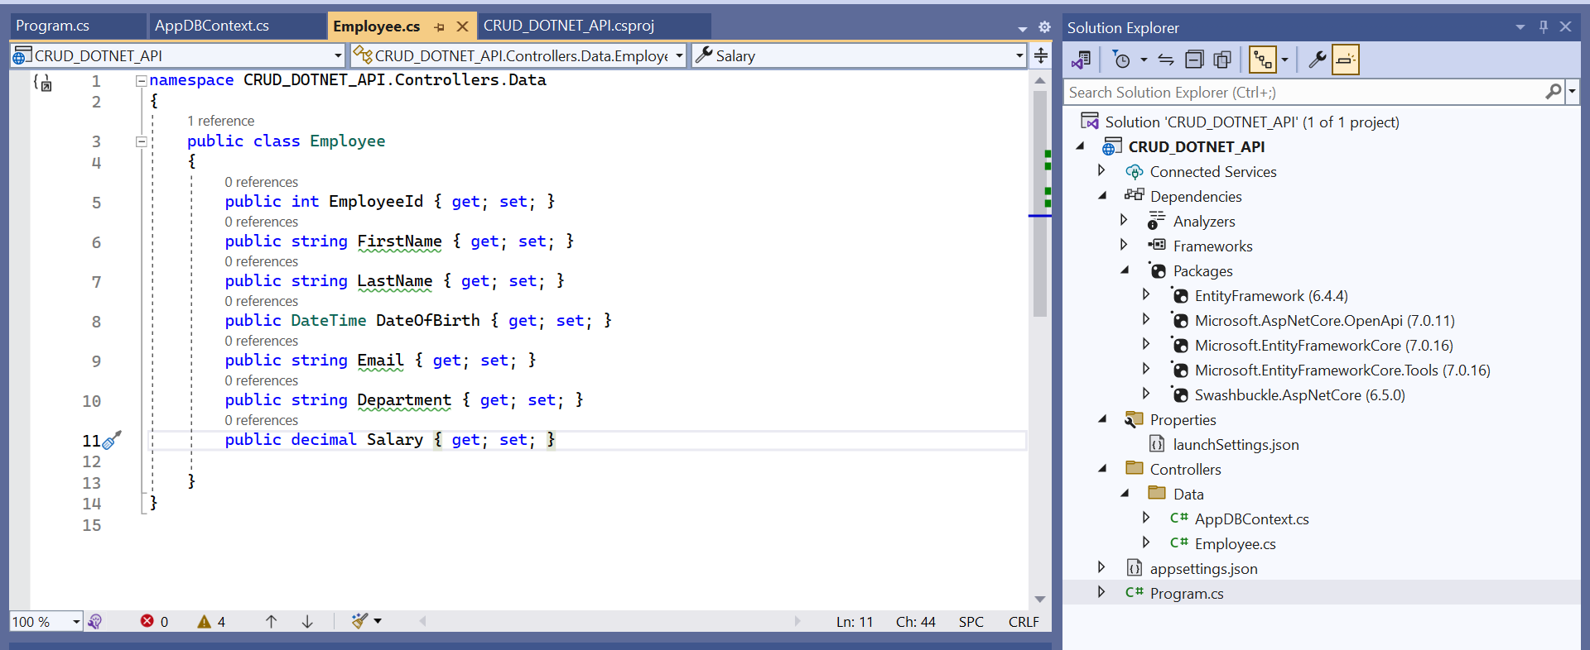
Create
Add below three nuget packages to the Visual Studio.
Entity Framework Core
Entity Framework Tools
Entity Framework SQL

Slide 73
Register AppDbContext in application
Add below three nuget packages to the Visual Studio.
Entity Framework Core
Entity Framework Tools
Entity Framework SQL
Microsoft.EntityFrameworkCore.SqlServer

Slide 74
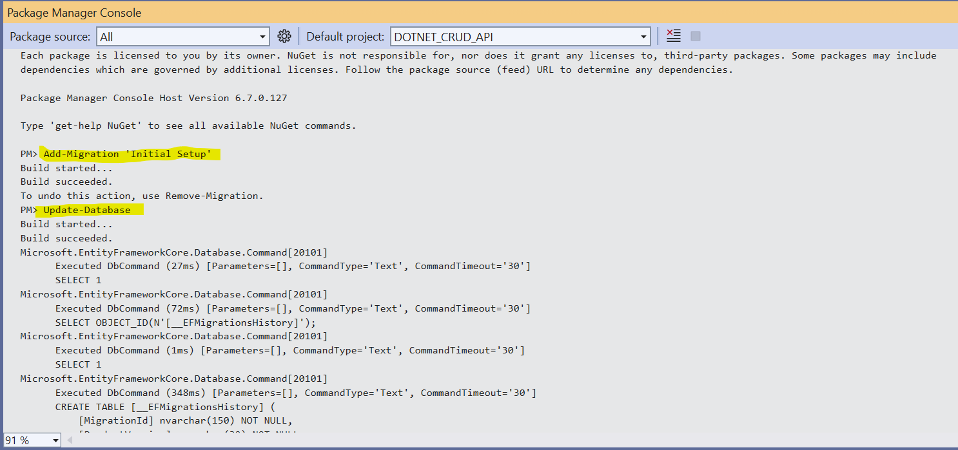
Execute Below Command to Create initial DB Setup
To open console ->Tools -> Nuget Package Manager -> Package Manager Console
If there is problem try changing <InvarientGlobalization> to False

Slide 75
28:44 Get employee method
45:18 .Net API Part Completed

Slide 76
Angular 17 ARC TUTORIAL
https://www.youtube.com/playlist?list=PLp50dWW_m40W6u4NxWCsQk1F8CmzBI6r0

Slide 77
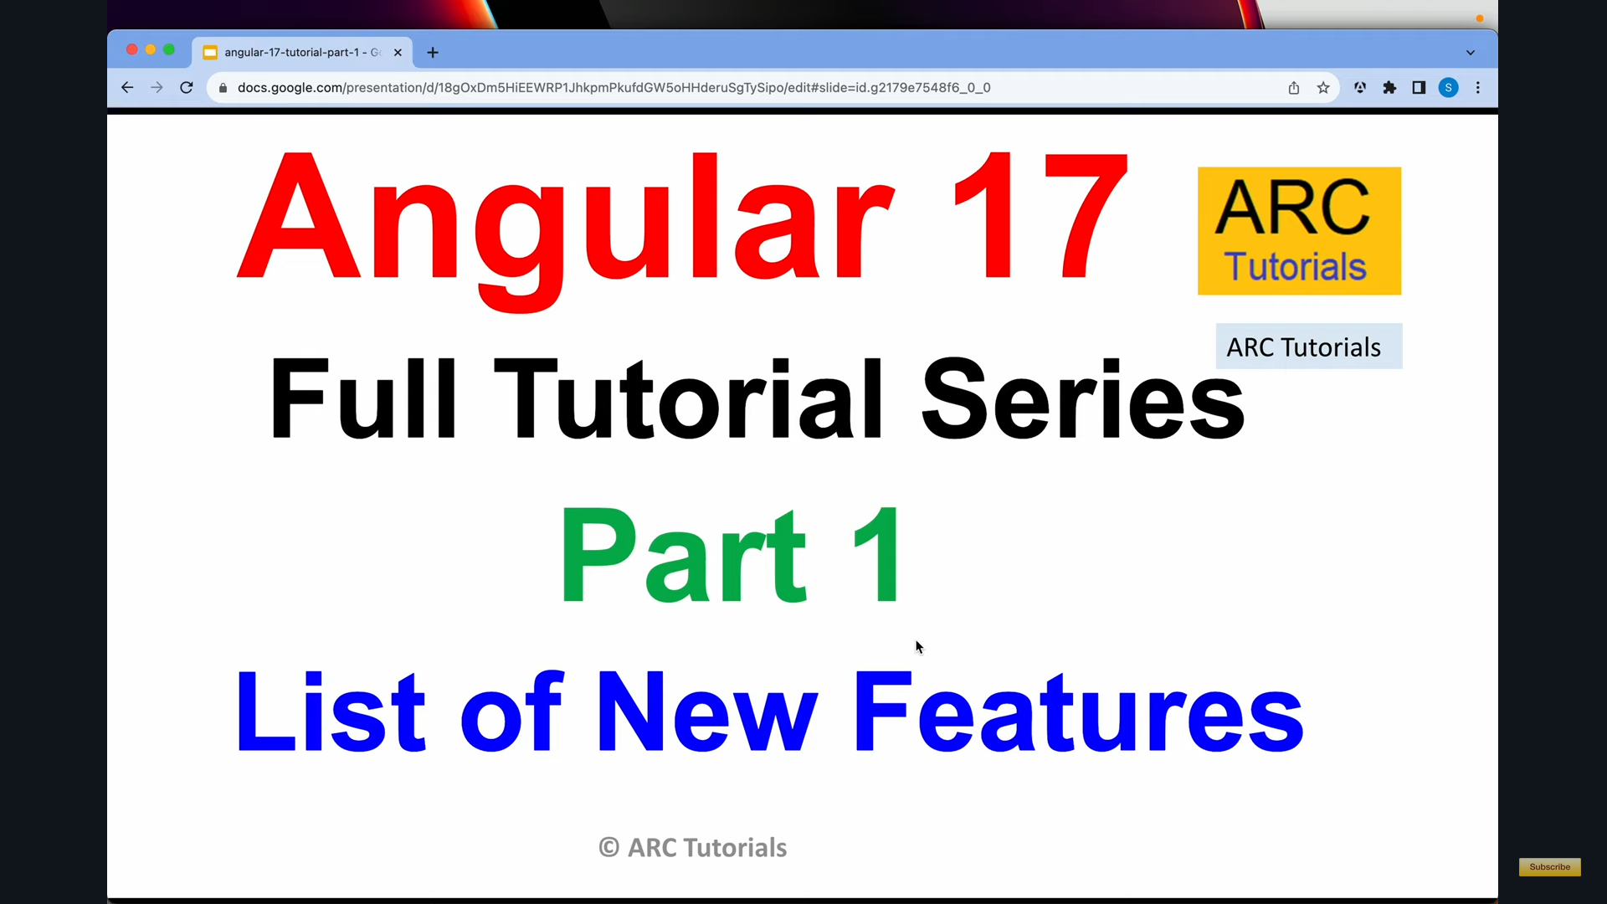
Angular 17

Slide 78
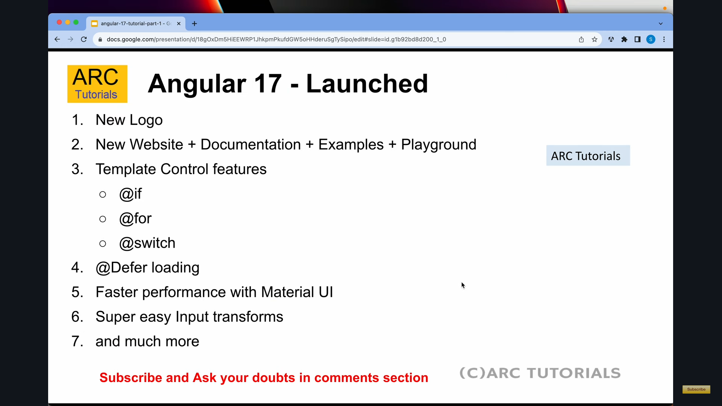
Angular 17

Slide 79
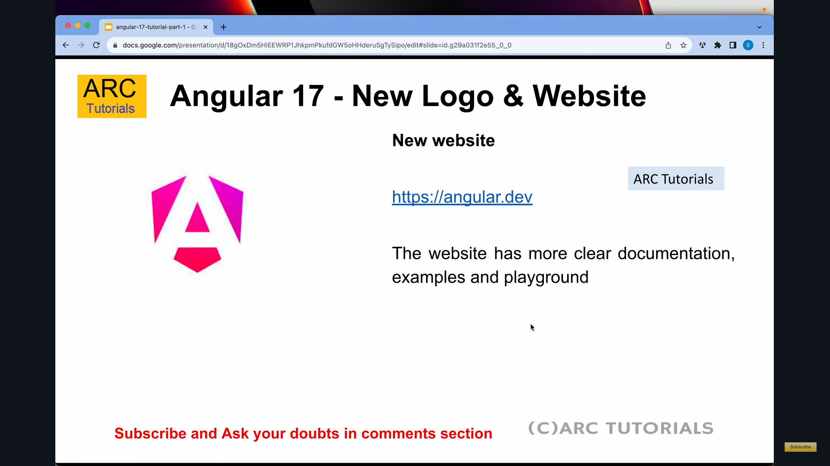
Angular 17

Slide 80
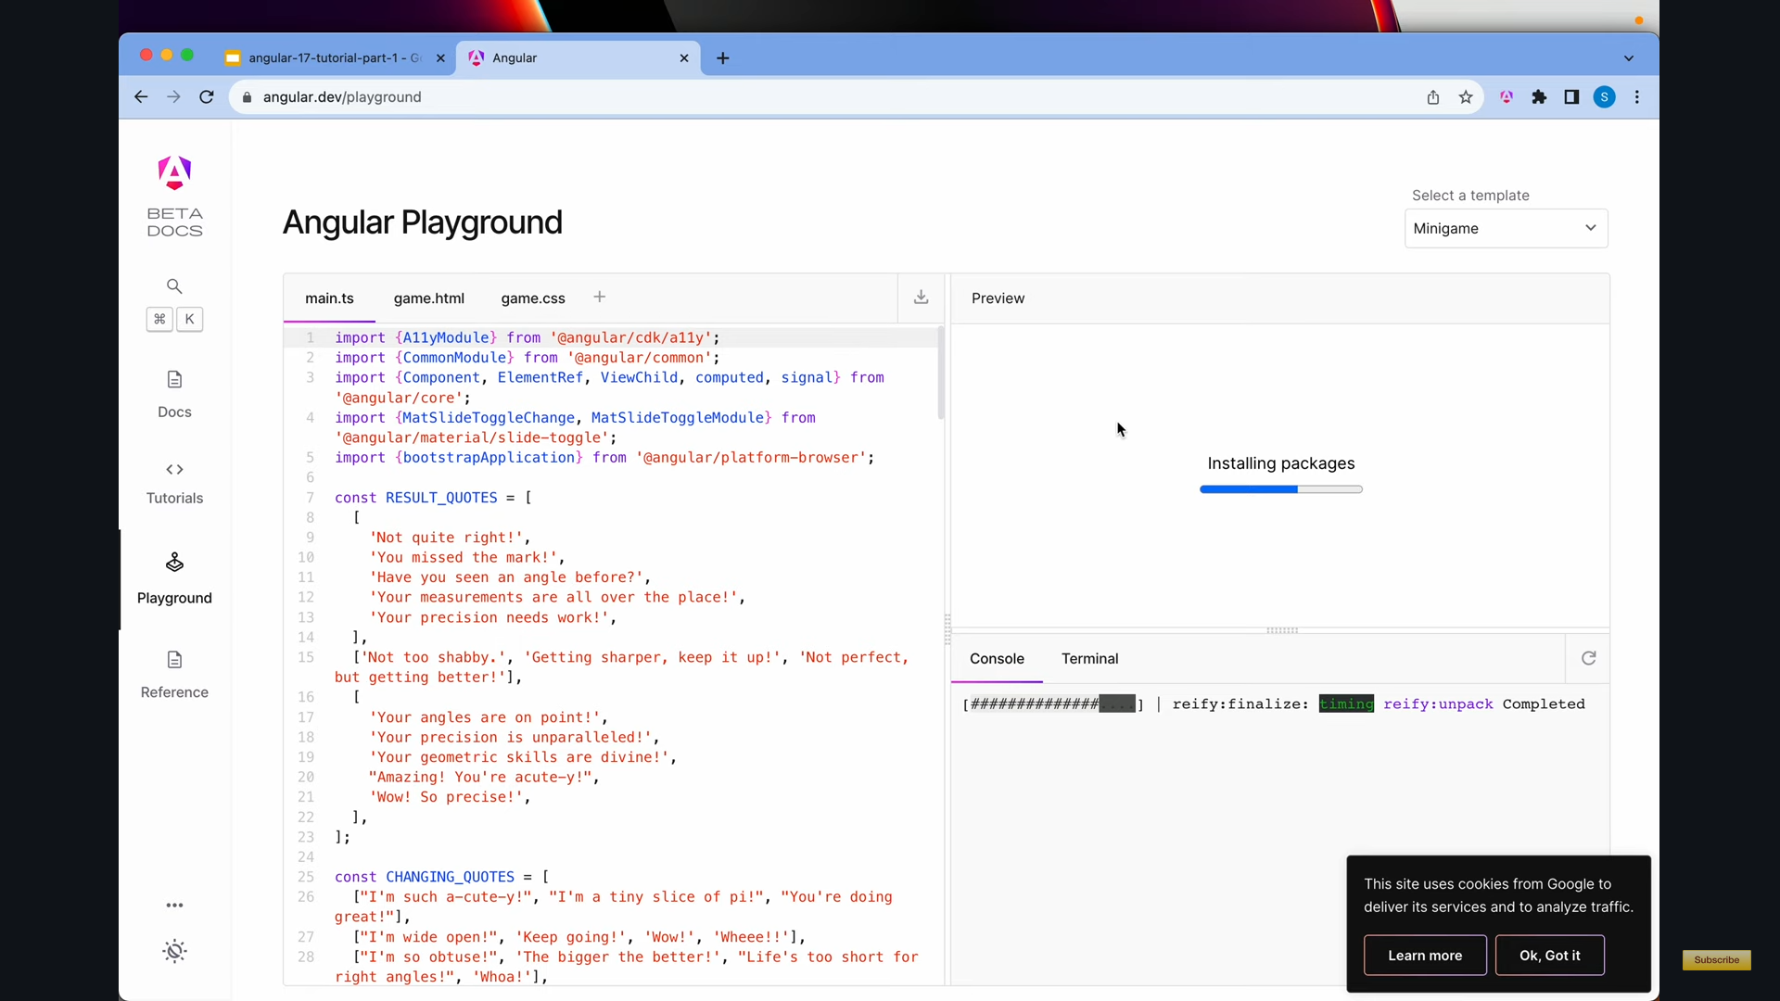
Angular 17

Slide 81
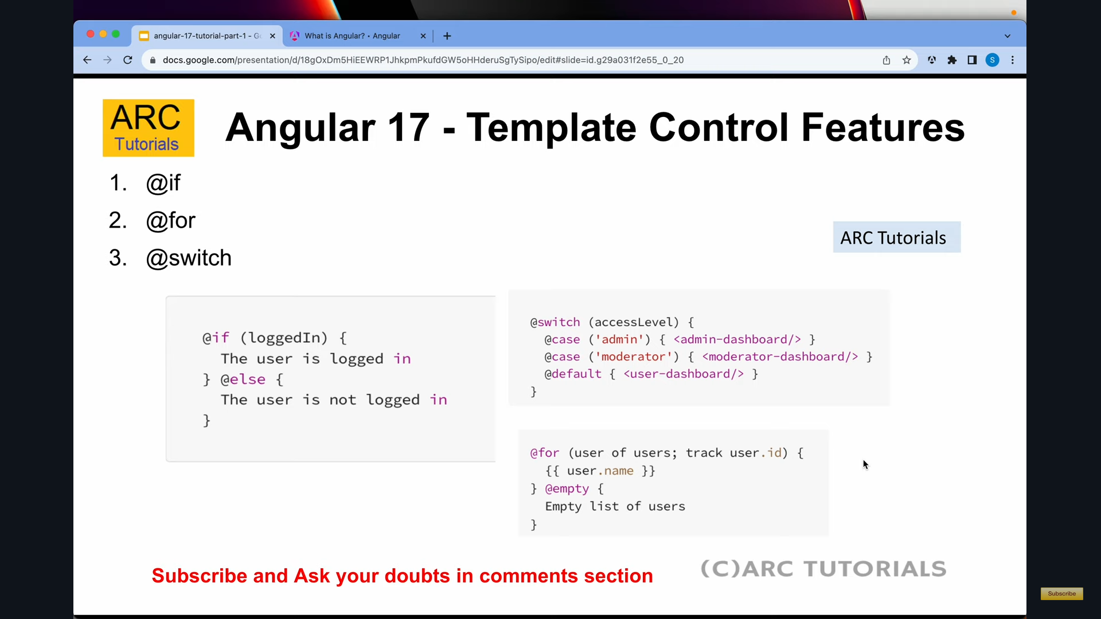
Angular 17

Slide 82
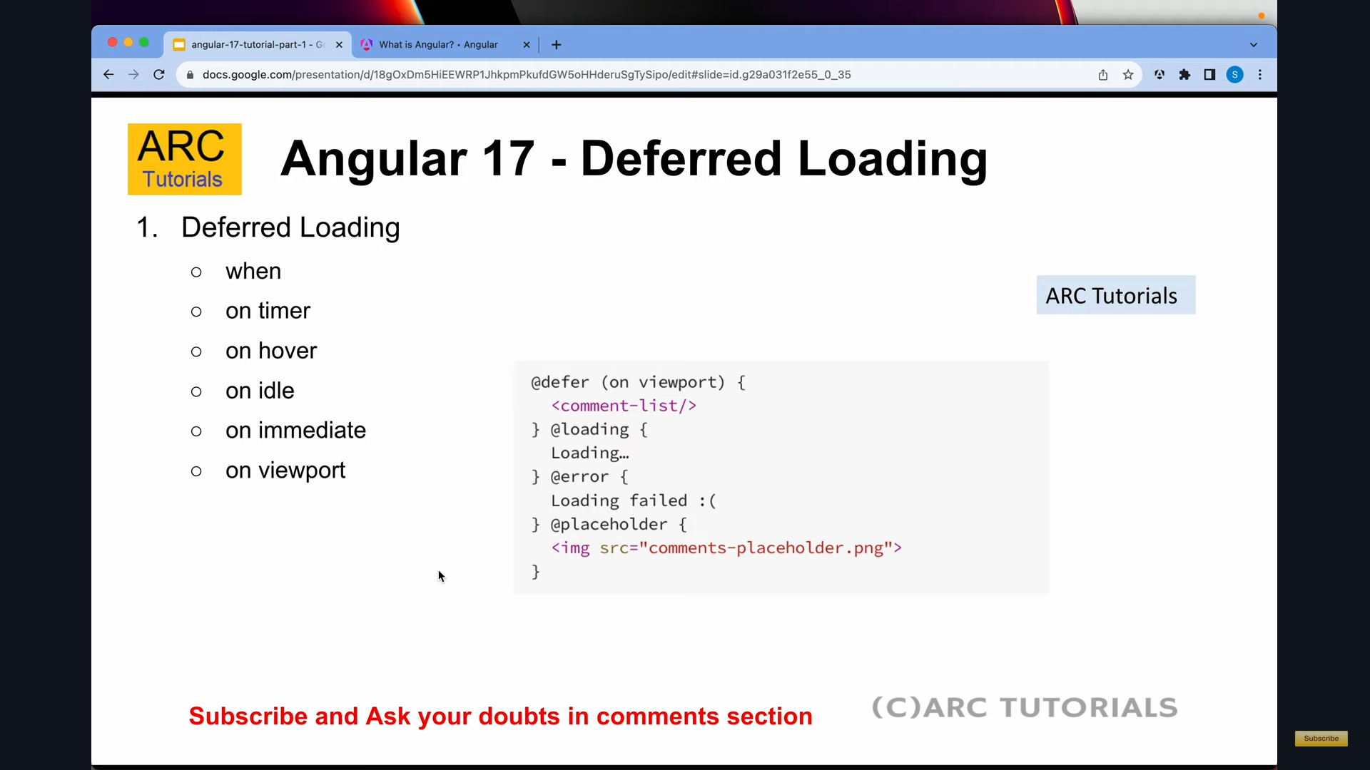
Angular 17

Slide 83
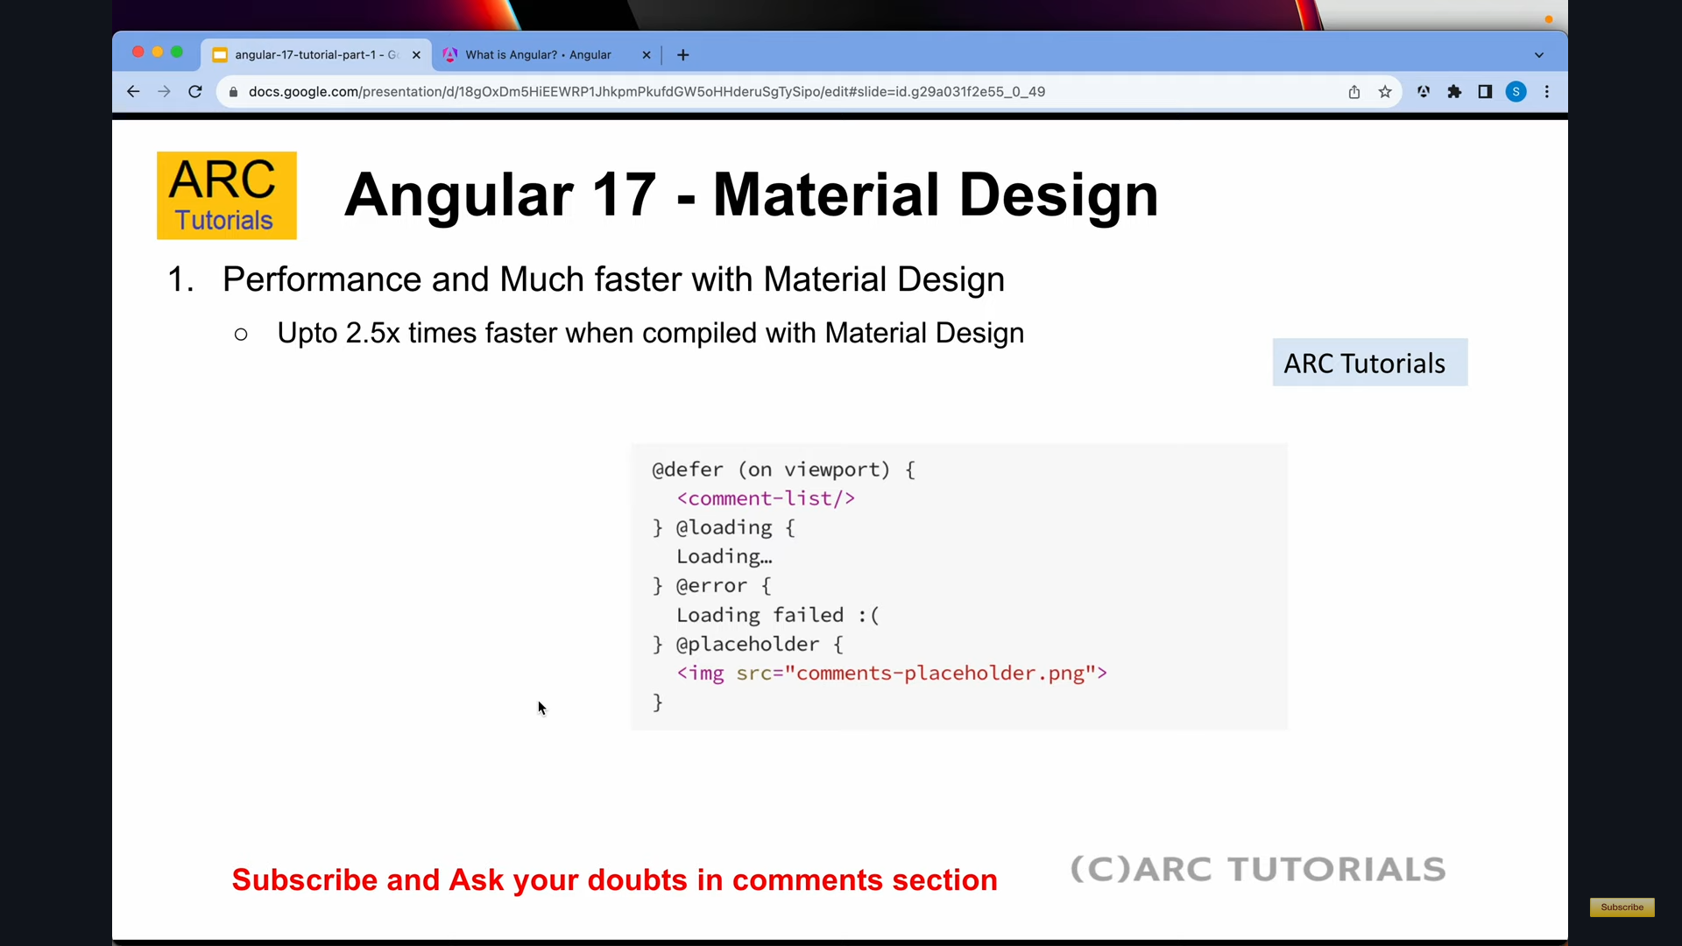
Angular 17

Slide 84
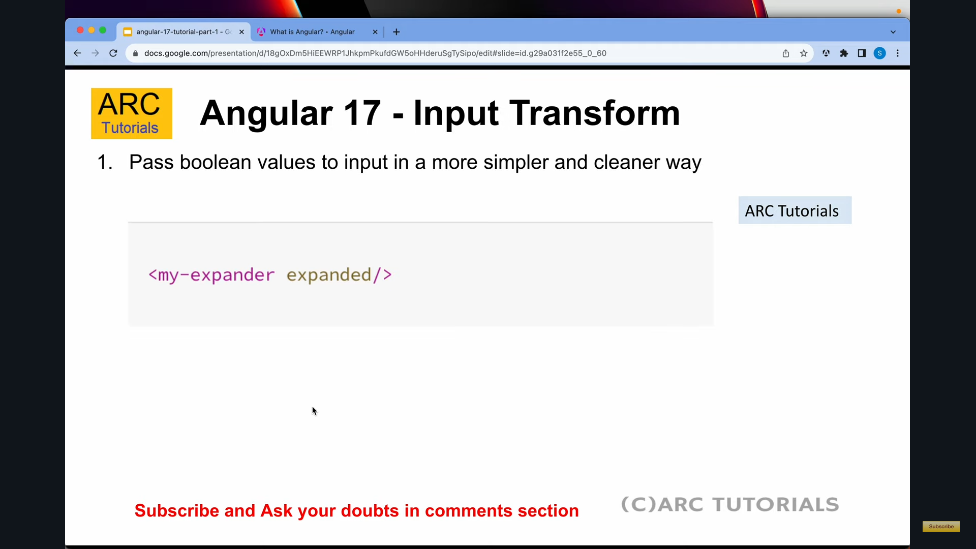
Angular 17

Slide 85
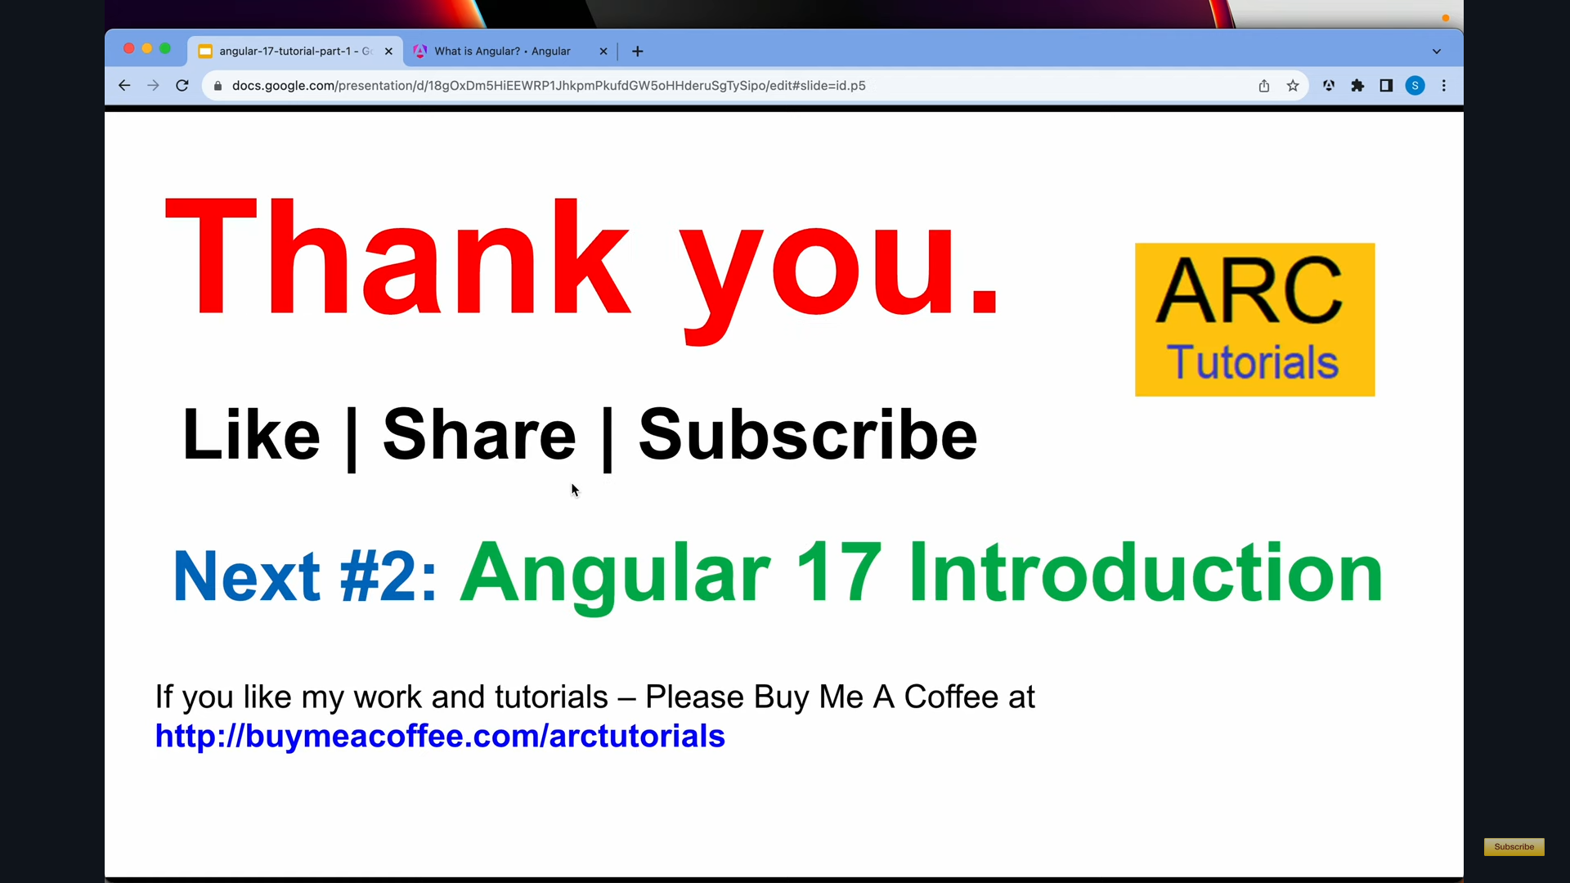
Angular 17

Slide 86
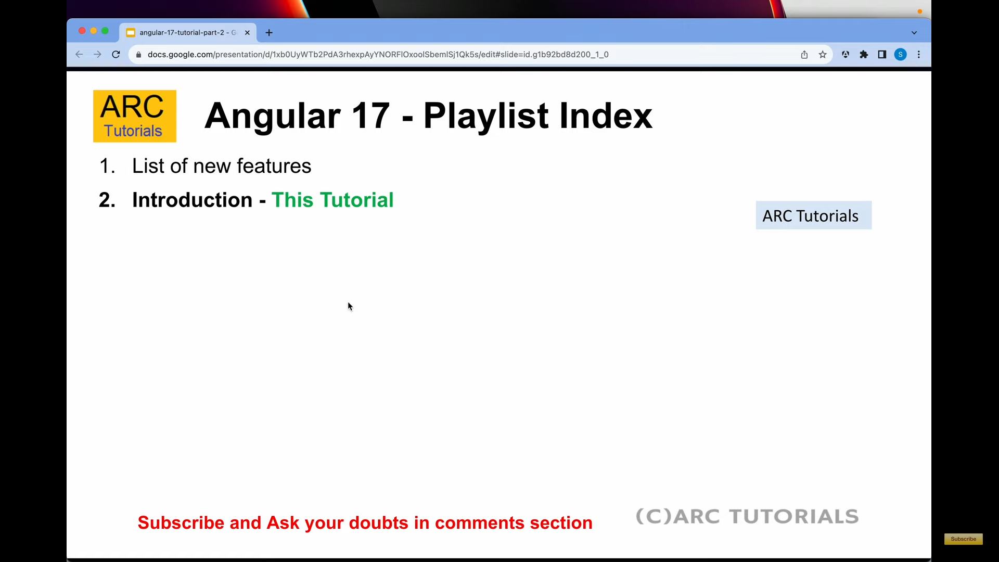
Angular 17

Slide 87
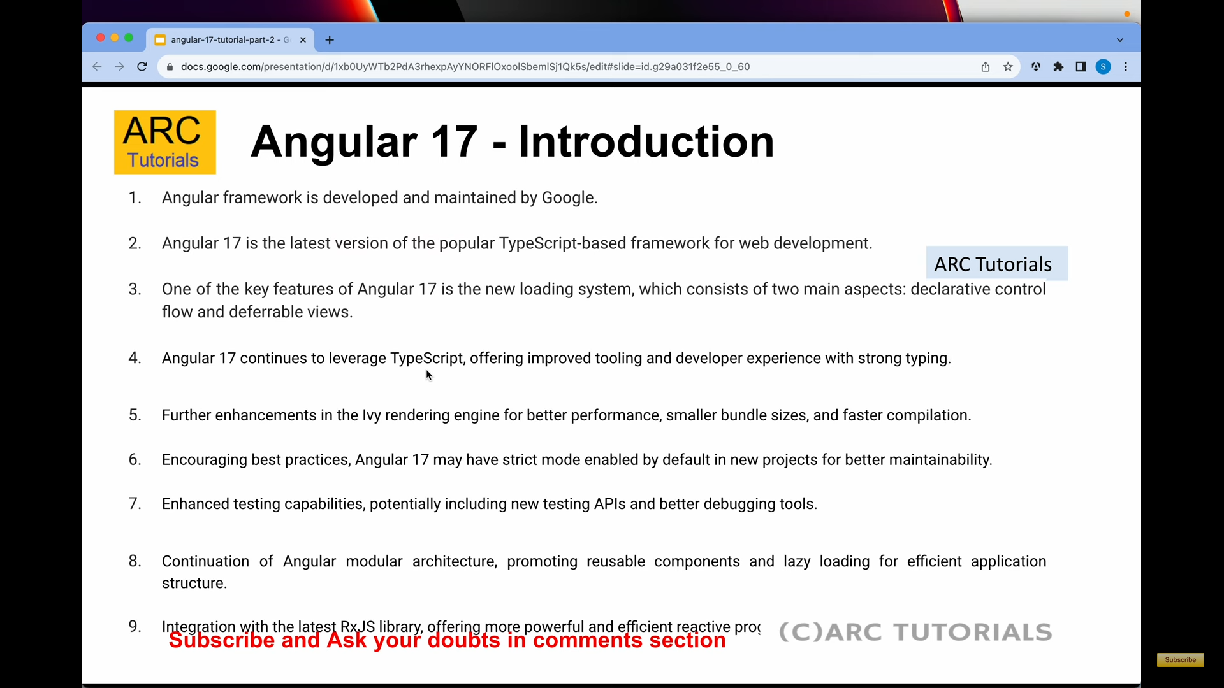
Angular 17 : How typescript and javascript are different?

Slide 88
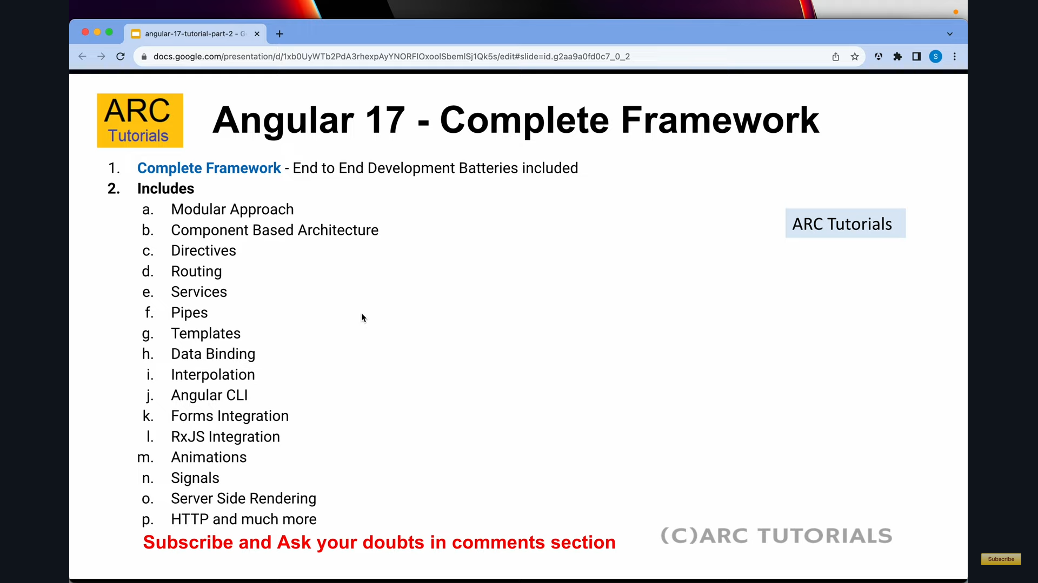
Angular 17

Slide 89
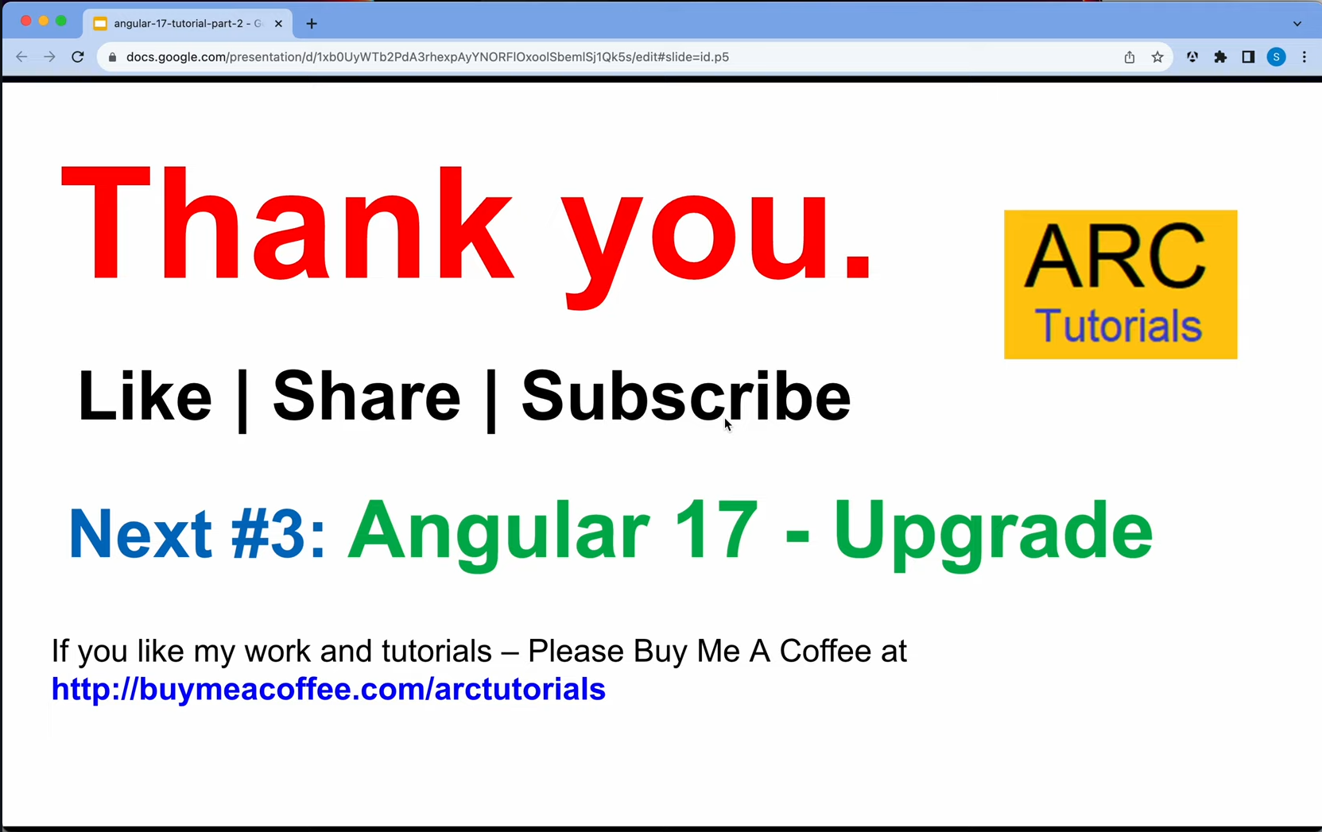
Angular 17

Slide 90

Angular 17

Slide 91
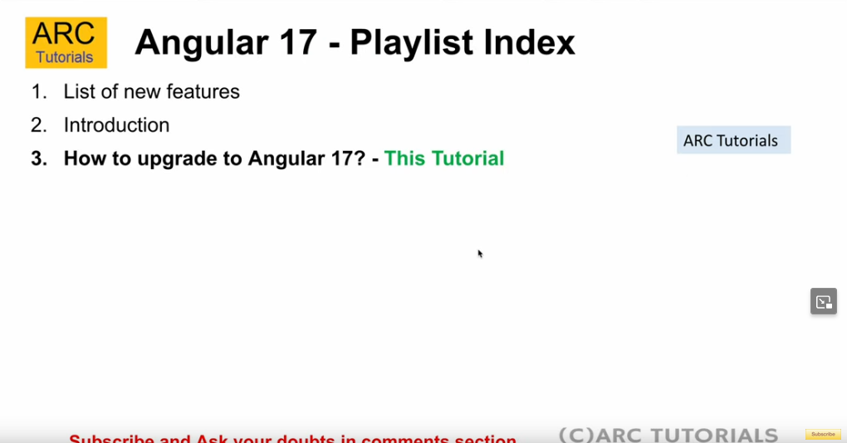
Angular 17

Slide 92
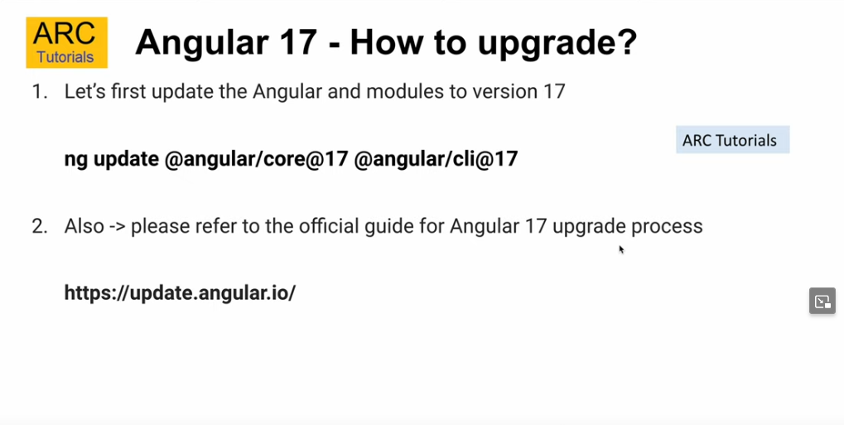
Angular 17

Slide 93
Angular 17
Part 3 no learning just best wishes to subscriber

Slide 94

Angular 17

Slide 95
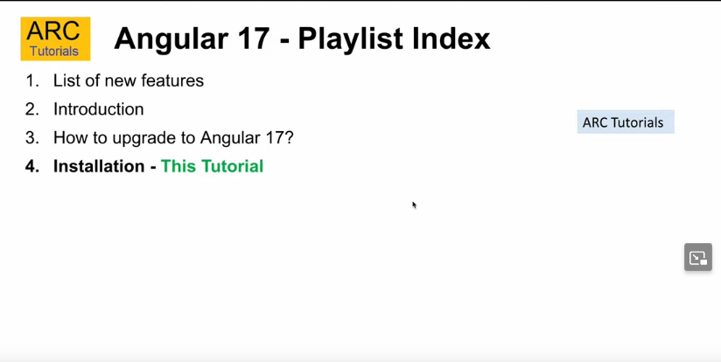
Angular 17

Slide 96
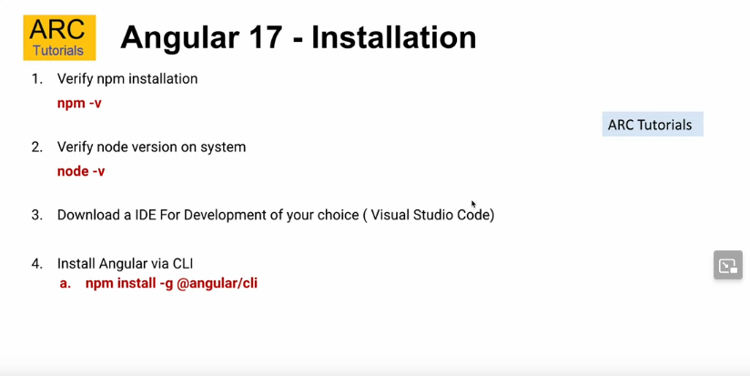
Angular 17

Slide 97
Angular 17
Visual studio code editor -> IDE that supports, typescript, javascript, Python etc.

Slide 98
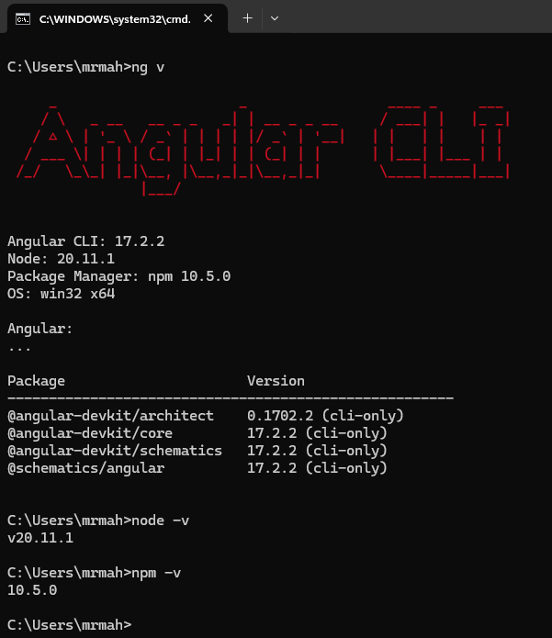
Angular 17
To check Versions
ng v ===to show angular CLI
Version
npm –v === to show
Node package manager Version
node –v to show node version
To install latest version of angular
npm install –g @angular/cli@17
npm install –g @angular/cli Also download latest version
To Create new Project
ng new Crew-Management
SCSS
Y
Navigate to directory CD directory
To Compile source code type
ng server
It will compile the source code and convert the files to javascript and CSS files.

Slide 99

Angular 17

Slide 100
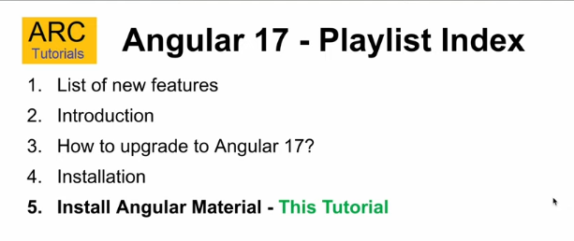
Angular 17 - Material Design components for Angular
Angular Material Design component consists of various components that are required for quick responsive front end design.
Angular Material UI component library

Slide 101
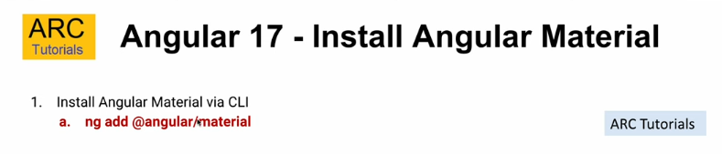
Angular 17 To install Angular Material
It is same like bootstrap for CSS
ng add @angular/material
Angular Material is a user interface (UI) component library that helps developers create
consistent and attractive web pages and applications for AngularJS.
It was developed by Google in 2014 and is based on Google's Material Design guidelines for
digital user experiences. Angular Material includes reusable components such as cards, inputs,
dialogs, data tables, and toolbars, as well as a component development kit (CDK) for creating
custom components.
Angular Material components come with default styling that follows the Material Design
Specification, but developers can easily customize their look and feel.
He library also includes features like in-built responsive design, standard CSS, and
specialized features like speed dial, side nav, and swipe.
To install angular Material UI hit ng add @angular/material
Select Y to install predefined / custom theme, Material topographic styles.
For more information https://material.angular.io/
https://material.angular.io/guide/getting-started

Slide 102
Angular 17 ************************
To add any Control style to webpage following things to be carried out.
Go to Angular Material UI component library
Copy the component code and add / replace to the project\src\app\app.component.html
Add headers to the project\src\app\app.component.ts
import {MatButtonModule} from '@angular/material/button’;
Add in @component section
imports: [RouterOutlet,MatButtonModule],

Slide 103

Angular 17 Install Bootstrap

Slide 104
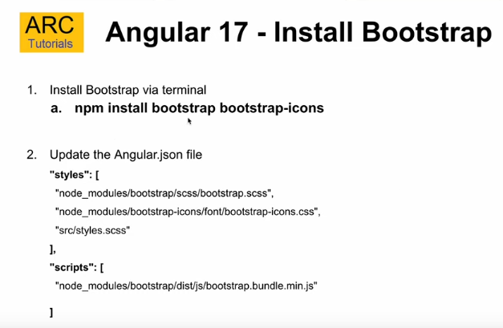
Angular 17 Install Bootstrap ***** 2 Ways to include
If installation of bootstrap is successful then update the path to angular.json file under the "styles":
By cross checking the path of boostrap.scss file
"node_module/bootstrap/scss/bootstrap.scss",
In the same way for the icon also
Finally style looks like
"styles": [
"node_module/bootstrap/scss/bootstrap.scss",
"node_module/bootstrap-icons/font/bootstrap-icons.scss",
"src/styles.scss"
],
Same can be done for the script tag

Slide 105
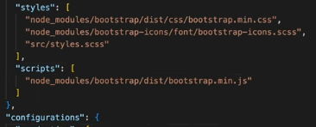
"scripts": [ "node_module/bootstrap/dist/css/bootstrap.min.js" ] Same can be done using another way
Angular 17 Install Bootstrap *****

Slide 106

Angular 17 Folder Structure and Files

Slide 107
Angular 17 Folder Structure and Files
Parent folder will be the main project folder
.angular -> Ignore this folder as it is used internally
.vscode -> Ignore this folder as it is used internally
Node_modules ->
See the Word Document at E:\WEB DEVELOPER\Angular In One\Angular 17.docx

Slide 108
Angular 17

Slide 109
Angular 17

Slide 110
Angular 17

Slide 111
Angular 17

Slide 112
Angular 17

Slide 113
Angular 17

Slide 114
Angular 17

Slide 115
Angular 17

Slide 117
What is the use of angular and framework ?
How does angular application starts, which files gets executed ?
Difference between angular and angular js
Life cycle of hooks (method in angular)
What are directives in Angular?
What are decorator/ meta data / Data Annotation in angular?
What is <!DOCTYPE html>?
Explain architecture of angular / angular building blocks.
What is SPA, how to implement SPA in Angular?
How we achieve lazy loading in angular?
Define services?
What is dependency injection ?
Difference between ng serve and ng build?
Use of CLI in angular?
Commands to create angular project?
npm install –g @angular : to install Angular
ng new project_Name : to create angular project

Slide 118

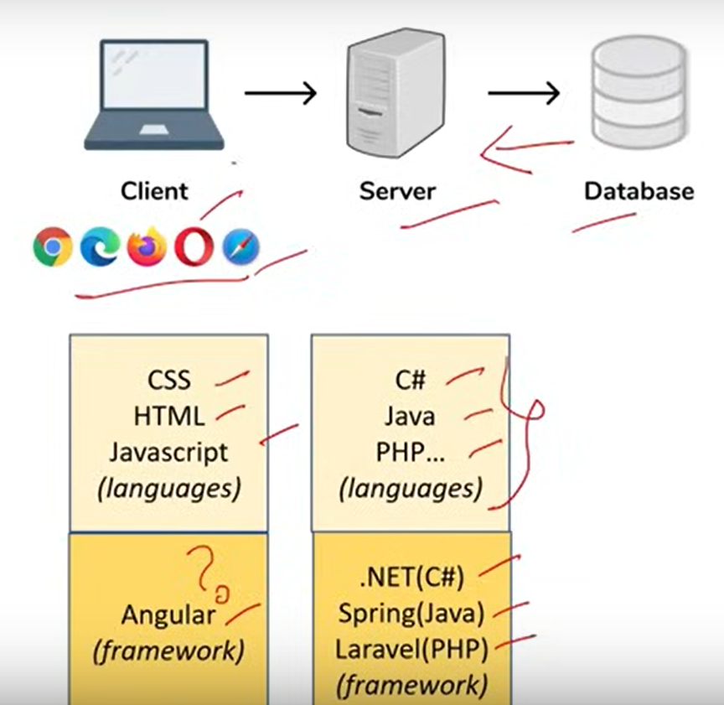
00:01:58 - What is Angular?
Angular is a component-based framework for building structured, scalable, and single-page web applications for client-side development.
Angular is a front-end web application framework developed by Google for building dynamic and interactive single-page applications (SPAs) using TypeScript.

Slide 119
00:04:50 - What are Angular advantages?
Build Single-Page Applications (SPAs): Angular is specifically designed for building SPAs, where a single HTML page is dynamically updated as the user interacts with the application, providing a seamless and fluid user experience.
Develop Component-Based Architecture: Angular promotes a component-based architecture, where the UI is divided into reusable and self-contained components. This modular approach simplifies development, maintenance, and testing of large-scale applications.
Handle Routing and Navigation: Angular provides robust routing and navigation capabilities, allowing you to define multiple views and manage navigation between them within your SPA.
Manage Application State: Angular supports state management techniques such as services, observables, and NgRx (a state management library), enabling efficient management of application state and data flow.
Handle Forms and User Input: Angular offers built-in support for both template-driven forms and reactive forms, making it easy to capture and validate user input, handle form submission, and manage form state.

Slide 120
00:04:50 - What are Angular advantages?
Interact with Backend Services: Angular provides HTTP client modules for making AJAX requests and interacting with backend services, enabling seamless integration with APIs and databases.
Implement Authentication and Authorization: Angular integrates seamlessly with authentication mechanisms such as JSON Web Tokens (JWT) and OAuth, allowing you to implement secure authentication and authorization features in your applications.
Perform Unit Testing and End-to-End Testing: Angular comes with built-in support for testing using tools like Jasmine and Protractor, allowing you to write and execute both unit tests and end-to-end tests to ensure the quality and reliability of your applications.
Optimize Performance: Angular offers various optimization techniques such as lazy loading modules, Ahead-of-Time (AOT) compilation, and tree shaking to improve the performance of your applications and enhance user experience.
Extend Functionality with Third-Party Libraries: Angular has a vibrant ecosystem of third-party libraries and extensions that you can use to extend its functionality and integrate additional features into your applications.

Slide 121
00:04:50 - What are Angular advantages?
It is relatively simple to build single page application(Components).
To make flexible and structured application(OOPS friendly).
It is cross platform and Open source(Free).
Reusable code(Services).
Testability(Spec.ts).

Slide 122
00:07:32 - What is the difference between AngularJS and Angular? Or what are the advantages of Angular over Angular JS?
Angular | Angular JS
Supports Javascript and TypeScript. | Supports only Javascript.
It has component based architecture. | It has MVC(Model-View-Controller) based architecture.
It has CLI tool. | It doesn’t have CLI tool.
It uses dependency injection. | It doesn’t use Dependency Injection.
It supports mobile browser. | It doesn’t support Mobile browser.
Ahead-of-Time (AOT) compiler | Just-In-Time (JIT) compiler
One-way and Two-way binding | Two-way binding
Better performance | Relatively slower
Smaller Bundle size | Larger Bundle size.

Slide 123
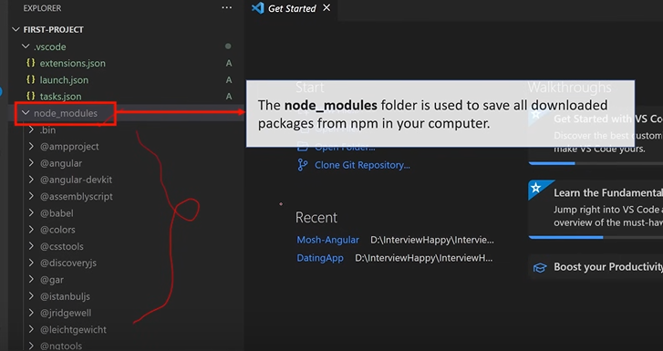
00:10:42 - What is NPM?
NPM / Node Package Manager is an online repository from where you can get thousands of free libraries which can be used in your angular project.
NPM is a tool that comes with Node.js, which is a JavaScript runtime environment.
NPM is used to install, manage, and share packages of code written in JavaScript.
These packages can range from small utility libraries to large frameworks and tools for building web applications.
Essentially, NPM allows developers to easily access and use code written by other developers, as well as share their own code with others.
It's like a big library of code that developers can tap into to speed up their development process and build more powerful applications.
To install Angular we need to first install Nodejs.

Slide 124
00:12:16 - What is CLI tool?
In the context of Angular, a CLI (Command Line Interface) tool refers to the Angular CLI. The Angular CLI is a powerful command-line interface tool that helps developers scaffold, build, and manage Angular applications more efficiently.
From CLI we can generate components, Modules, Services etc for angular project.
CLI is a command line interface tool that we use to initialize and develop angular application.

Slide 125
What are Components in Angular?
Components are the building blocks of an application's user interface. They encapsulate the behavior and presentation of a part of the UI, making it reusable and modular. Each component consists of three main parts: the template, the class, and the metadata.
Template: The template is the HTML markup that defines the component's view. It includes bindings and directives that allow data to be dynamically rendered and manipulated. Templates can also include Angular-specific syntax such as interpolation ({{ }}), property binding ([ ]), event binding (( )), and structural directives (*ngFor, *ngIf, etc.).
Class: The class is the TypeScript code that defines the component's behavior. It contains properties and methods that interact with the component's template and handle user interactions. The class is responsible for managing the component's data and responding to events.
Metadata: The metadata is represented by the @Component decorator in Angular. It provides additional information about the component, such as its selector, template URL or inline template, styles, and more. Metadata allows Angular to understand how the component should be processed and rendered.

Slide 126
What are Components in Angular?
Component
The top section represents the component as a whole.
The @Component metadata defines additional information about the component.
The template section contains the HTML markup that defines the component's view.
The class section contains the TypeScript code that defines the component's behavior.
Components in Angular follow a hierarchical structure, allowing complex applications to be broken down into smaller, reusable pieces. This promotes maintainability, testability, and scalability of Angular applications.
@Component Metadata
Template
(HTML Markup)
Class (Typscript Code)

Slide 127
What is a Selector and Template?

Slide 128
00:13:57 - Section 2 00:14:25 - What are Components in Angular? 00:17:14 - What is a Selector and Template? 00:18:40 - What is Module in Angular? What is app.module.ts file? 00:21:43 - How an Angular App gets Loaded and Started? What are index.html, app-root, selector and main.ts? 00:25:42 - What is a Bootstrapped Module & Bootstrapped Component?

Slide 129
00:13:57 - Section 2 00:14:25 - What are Components in Angular? 00:17:14 - What is a Selector and Template? 00:18:40 - What is Module in Angular? What is app.module.ts file? 00:21:43 - How an Angular App gets Loaded and Started? What are index.html, app-root, selector and main.ts? 00:25:42 - What is a Bootstrapped Module & Bootstrapped Component?

Slide 130
00:13:57 - Section 2 00:14:25 - What are Components in Angular? 00:17:14 - What is a Selector and Template? 00:18:40 - What is Module in Angular? What is app.module.ts file? 00:21:43 - How an Angular App gets Loaded and Started? What are index.html, app-root, selector and main.ts? 00:25:42 - What is a Bootstrapped Module & Bootstrapped Component?

Slide 131
00:13:57 - Section 2 00:14:25 - What are Components in Angular? 00:17:14 - What is a Selector and Template? 00:18:40 - What is Module in Angular? What is app.module.ts file? 00:21:43 - How an Angular App gets Loaded and Started? What are index.html, app-root, selector and main.ts? 00:25:42 - What is a Bootstrapped Module & Bootstrapped Component?

Slide 132
00:41:55 - Section 4 00:42:19 - What are Directives? What are the type of directives? 00:44:49 - What is *ngIf Structural directive? 00:46:43 - What is *ngFor Structural directive? 00:48:06 - What is *ngSwitch Structural directive? 00:50:35 - What is [ngStyle] Attribute directive? 00:53:45 - What is [ngClass] Attribute directive? 00:56:26 - What is the difference between Component, Attribute and Structural Directives?

Slide 133
00:41:55 - Section 4 00:42:19 - What are Directives? What are the type of directives? 00:44:49 - What is *ngIf Structural directive? 00:46:43 - What is *ngFor Structural directive? 00:48:06 - What is *ngSwitch Structural directive? 00:50:35 - What is [ngStyle] Attribute directive? 00:53:45 - What is [ngClass] Attribute directive? 00:56:26 - What is the difference between Component, Attribute and Structural Directives?

Slide 134
00:58:08 - Section 5 00:58:29 - What is Decorator? 01:00:15 - What are the types of Decorator? 01:01:05 - What are Pipes? What are the types of Pipes & Parameterized Pipes? 01:03:25 - What is Chaining Pipes?

Slide 135
01:04:14 - Section 6 01:04:38 - Explain Services with Example? 01:06:32 - How to create Servicein Angular? 01:10:04 - How to use Dependency Injector with Services in Angular? 01:11:56 - What is Hierarchical Dependency Injection? 01:14:34 - What is Provider in Angular? 01:15:46 - What is the role of @Injectable Decorator in a Service?

Slide 136
01:19:57 - Section 7 01:20:11 - What are Parent-Child Components? 01:23:40 - What are Lifecycle Hooks in Angular? 01:27:09 - What is a Constructor in Angular? 01:29:24 - What is ngOnInit life cycle hook in Angular? 01:30:52 - What is the difference between constructor and ngOnInit?

Slide 137
01:35:21 - Section 8 01:36:01 - What are Asynchronous operations? 01:38:20 - What is the difference between Promise and Observable? 01:42:47 - What is RxJS? 01:45:21 - What is Observable? How to implement Observable 01:50:10 - What is the role of HttpClient in Angular?

Slide 138
01:51:26 - Section 9 01:51:50 - What is Typescript? Or What is the difference between Typescript and Javascript? 01:57:55 - What is the difference between let and var keyword? 2:00:59 - What is Type annotation? 02:02:27 - What are Built in/ Primitive and User-Defined/ Non-primitive Types in Typescript? 02:04:21 - What is “any” type in Typescript? 02:06:37 - What is Enum type in Typescript? 02:08:48 - What is Type Assertion in Typescript? 02:10:47 - What are Arrow Functions in Typescript?

Slide 139
Component and life cycle hooks
Routing
Observables\HTTPClient\RxJS
Typescript Basics
Typescript OOPS
Angular Forms
Authentication
Component communication

